Slide 1
Digital Product Innovation in the Public Service
Inclusive Design
Notes:
Original version presented by Heidi Leckenby to a CSI Labs Lunch and Lab.

Slide 2
Just Quickly …
Inclusive Design vs Accessibility
Notes:
Heidi

Slide 3
Overview
Look at statistics/who’s who at the zoo
Understand barriers
Standards, law, why
How
Scope and scale of the issue for this IMB
Demonstrations
A whole bunch of questions and chatter
Notes:
Political correctness traps. No offense intended.

Slide 4
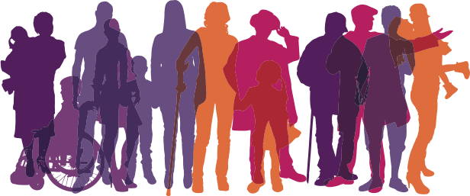
Statistically Speaking
2011 – 3.7 million British Columbians self identified as a person with a disability (15%)
Seniors represent 17.5% of the population of which 33% are registered PWDs
Notes:
Many persons with disabilities are educated, work and are members of society.
To qualify for PWD, applicants must:
• be at least 18 years of age
• have a severe mental or physical impairment that, in a medical doctor’s opinion, will likely continue for at least two or more years.
US identifies approximately 25% of its population.

Slide 5
but
Notes:
We all know that being registered doesn’t actually provide us with true numbers
We have “hidden” members of society that aren’t registered.
Could be
Slow incremental physical or mental condition
Sudden physical or mental condition
Borderline and don’t qualify for PWD
So let us understand what we mean by providing accessible services …

Slide 6

Disability Barriers
Cognitive – traumatic brain injury, autism, learning disorder, down syndrome, dementia
Motor – traumatic injury, congenital disease
Visual – legally blind, colour-blindness
Auditory – conductive hearing loss, neural hearing loss, high/low tone deafness
Seizures – vestibular disorders
Question:
What do you think are the most prevalent disabilities?
Notes:
These are PWD recognized conditions, which generally cause an impact to daily activity for more than a 2 year period.
Crowd question … shout out what you think are the most prevalent disabilities?
Note:
There is a higher prevalence of users with learning/reading/cognitive barriers than there are blind. In fact colour blindness and dyslexia are more common than blindness as well BUT we know how to code for screen readers.
Why do we think of blind or deaf as the most common?
Advocates … businesses, technology, it’s more “in your face”. By focusing on a particular higher profile disability we risk ignoring or even introducing other barriers.
(HEIDI: Can we refine this – I’m not sure what this is meant to convey?) [Heidi] Gav, it is just some conversation point … most designers build toward one kind of barrier group, still blocking use for others.

Slide 7
Understanding
Disability
… physical, sensory or mental long term impairment that substantially impacts interaction with daily life
Inclusive Design /Accessibility
… the flexibility to accommodate every user’s needs and preferences when interacting with products, services and environments
vs
Notes:
So here we see the sift of not focussing on disability but including everyone through accessibility.
Disabilities - Persons with disabilities include those who have long-term physical, mental, intellectual or sensory impairments which in interaction with various barriers may hinder their full and effective participation in society on an equal basis with others
Accessibility - The provision of flexibility to accommodate each user’s needs and preferences. When used in reference to persons with disabilities, any place, space, item or service, whether physical or virtual, that is easily approached, reached, entered, exited, interacted with, understood or otherwise used by persons of varying disabilities, is determined to be accessible.

Slide 8
Societal Barriers
Attitudinal – discriminatory behaviour
Systemic – processes, policies or legislation preventing individual participation
Physical – inability to gain access or participate
Informational – sensory (sight, hearing, motor) or cognitive exclusion to information and services
Technological – lack of device or platform diversity or inability to interact with assistive devices
Notes:
By looking through the accessibility lens we are not only catering for those in grey in the earlier slide through disabilities, we are catering for all users which could come from differing cultures, socioeconomic differences, location …
(HEIDI – which previous slide? [Heidi] Gav, it’s the one talking about numbers/prevalance)
Other considerations of accessibility relate to:
Socio-economic status
Persons in remote areas
Persons in differently governed environments (First Nations)
Persons that do not have access to technology or at least the very latest technology
Mostly we look here at the marginalized persons that struggle to gain access to fair services due to some kind of barrier that inhibits them from interacting as the majority do.

Slide 9
Aim of Inclusive Design (#a11y)
Provide services and information that give a person a sense of dignity, independence, integration and equal opportunity
The best thing about inclusive design … simplicity, sound design, success through improved uptake, reduced errors, reduced enquiries, inclusion
Notes:
“There is a deeply sad irony in the idea that people who are all about inclusion use a cryptic Twitter hashtag that excludes all but the elite who have been clued into what it’s supposed to mean.” [Heidi] Gav, it this a little add on you’d like to bring in?

Slide 10

What happens
Insufficient opportunity to interact
Limited ability to gain knowledge, information or access
Infringement of fundamental rights
Exclusion
Social isolation
Strain on individual and supports
Life quality deterioration
Frustration
Notes:
The simple beginnings of not being able to interact, whether through government services or labour market or social, provides barriers to an individual’s capacity to not only succeed but to survive as well.
Here we begin with “insufficient opportunity to interact” … as simple as a person wishing to swim that is in a wheel chair with moderate brain injury (cognitive delay) which causes some vision loss …
They search the internet to find a location to swim
The swimming pool websites are difficult to navigate, too much information, colour contrasting makes it difficult to figure out buttons from text, the user enlarges their screen with Zoomtext so they have difficulty navigating around the site because the important information isn’t located together, the site page loops or skips content when they try to use the keyboard to tab through the page to the search box
So they give up and call after finding a phone number on the site
Determined, they end up finding a time to go swimming, they’ve only found one location which is 30kms away from their home that provides wheelchair access to the building, an accessible washroom and a loading crane for the pool and an assisted swimming program with assistive devices.
This person will have to change busses 3 times to reach the location.

Slide 11
And here’s some more reasons why
1 … 2 … 3 … 4

Slide 12
1 …
Standards of Conduct for Public Service Employees – Human Resources Policy 09
Service to the Public
BC Public Service employees must provide service to the public in a manner that is courteous, professional, equitable, efficient, and effective. Employees must be sensitive and responsive to the changing needs, expectations, and rights of a diverse public in the proper performance of their duties.
Notes:
Anyone remember reading the standards of conduct when they started at the BCPS?
We, as public servants, have an duty to accommodate any person that interacts with government through the work we do

Slide 13
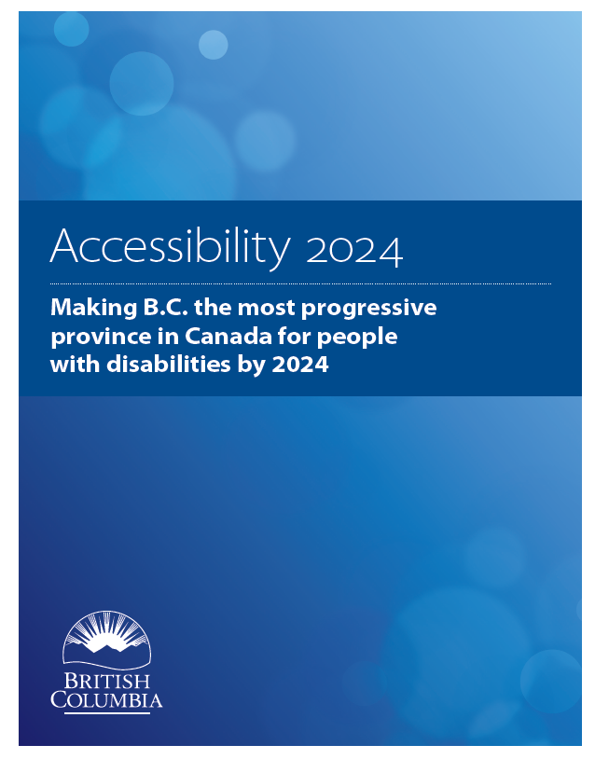
… 2 …
Accessibility 2024 ten year action plan
12 building blocks to address government’s commitment to accessibility
Notes:
Public consultation to understand the needs of disabilities in bc
Accessibility secretariat
Supports the United Nations Convention on the Rights of Persons with Disabilities
that looks at all aspects of government’s interaction with individuals addressing needs of accessibility

Slide 14
… 3 …
BC Human Rights Code 1996
Discrimination in accommodation, service and facility
8 (1) A person must not, without a bona fide and reasonable justification,
(a) deny to a person or class of persons any accommodation, service or facility customarily available to the public, or
(b) discriminate against a person or class of persons regarding any accommodation, service or facility customarily available to the public
because of the race, colour, ancestry, place of origin, religion, marital status, family status, physical or mental disability, sex, sexual orientation, gender identity or expression, or age of that person or class of persons.
Notes:
Challenge to federal websites filed by Donna Jodhan of Toronto. She is legally blind and is a sophisticated computer user. Despite being computer savvy, Jodhan was unable to access the federal government's informational and transactional services online. She sued and cited five examples of inaccessible online services, and in November 2010 the Federal Court agreed with her.

Slide 15
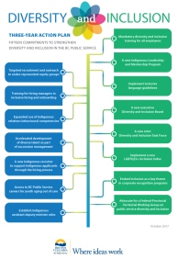
… and 4
BC Government’s Diversity & Inclusion Action Plan
Notes:
Just in the last couple months the government released its Diversity and Inclusion Action plan which lays out the foundation for how we work. Although largely catering for the internal staff membership, this helps support the need to ensure we design fairly.

Slide 16
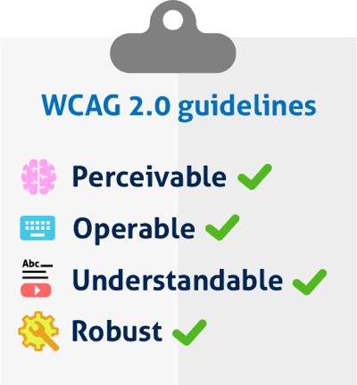
Accessibility Standards
World Wide Web Consortium (W3C)
Web Content Accessibility Guidelines (WCAG)
4 Principles
Notes:
W3C is a collaborative international group of member organizations, staff, and public
WCAG was developed by these people.
Accessibility for Ontarians with Disabilities Act (AODA) – WCAG 2.0 AA
Priority levels:
A – minimum level must be achieved
AA – is the level of WCAG 2.0 that is to be achieved
AAA – providing specialized enhancements

Slide 17
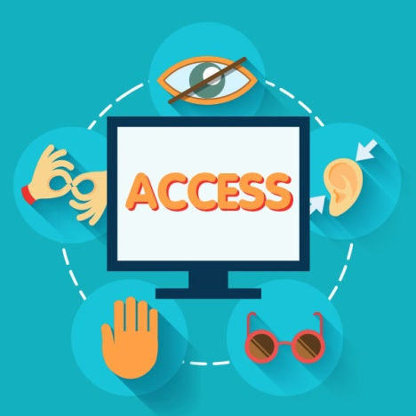
WCAG Principles
Perceivable
All elements can be perceived and used
Operable
All users can navigate and participate
Understandable
Anyone can understand how to interact
Robust
Can be used on any device, anywhere, anyhow

Slide 18

How? Design fundamentals
Overview of how to approach design …
Notes:
#1 User research AND personas for all types
#2 Create simple work flows and use plain language
#3 Design UI with colour contrasting, responsive design, easy to navigate
#4 Code for keyboard control, assistive technology, multiple devices
#5 Test/audit using the right tools and methods
#6 Test with real people from your personas
Design process – note legally providing other avenue is not sufficient. Users are entitled to use the same method as anyone else … it is by personal preference alone that the other avenue is okay.
In the background, change business rules/policy to adapt to accommodate.
Include accessibility in the development cycles of projects by:
Personas - Create personas to cover all potential users
Process - Make sure your process is available and easy to interact with for all personas
Write - Use plain language and as little wording as possible
Display/Render
Use icons (with alt text or labelling), simple flowing layouts, colour contrasting, transcripts, responsive
Code
Build into the foundations of how you code the basics to enable tab navigation and screen reader interaction

Slide 19
Personas
Create personas to accommodate persons with barriers in:
Sight – screen readers/screen enlargement
Hearing – plain language/icons/transcripts
Motor – keyboard/tab navigation
Cognitive – simple design, plain language

Slide 20
UI Design
Easy to understand and navigate processes
Colour contrast
Use plain language and icons
Content structure – headings, lists, links, data
Page elements – semantic order, alt text, alerts, form fields, buttons

Slide 21
Coding
Provide skip to links
Inform users – alt text, alerts, popups
ARIA page zones
Responsive design
Tab order
Labels

Slide 22
Testing
Manual tab/keyboard tests
Online tests
Multiple device, platform, browser tests
Screen reader tests
Check the code
Cognitive Barrier check – process, workflow
User testing
Notes:
I don’t know how we might address automated testing.
Some work has been done on this in the last couple of years
mostly by jury rigging unit test code acquired from Google Chrome GitHub repo – but this wasn’t the intent of that
No manual or automated testing is a substitute for user test – NOT business acceptance testing (most commonly used for UAT)

Slide 23
Activity in Gov
GCPE/GDX
Auditing and advisory services
Outreach to developer networks
Continual development of guides on gov.bc.ca
Service Design project focussed on inclusive design
Accessibility Secretariat (MTIC)
Out reach and Accessibility 2024

Slide 24
Scope of Considerations
Build into project processes – start to finish
Procurement
EOI, RFP, Statements of Work, etc.
Design and development
Testing
Notes:
Whether procuring development or COTS, requirements around accessibility should be stated
Might be as short as simply requiring adherence to the published WCAG standards.
We might want to allow for the contracted resource to provide a good and strong reason if some accessibility feature can’t be met….
Thinking of a map based application here.
Our difficulty will be to test for contract fulfillment.
but if accessibility is made a part of the design process and testing occurs throughout the lifetime of the development, then we can at least have some reasonable assurance.
Agile and it’s scrum/sprint model of delivery lends itself well here. Waterfall approaches will need to ensure that accessibility is NOT an afterthought but built in throughout each sub process.
Provide current sample contract/RFP language?

Slide 25
Tools
Several categories of testing tools
Online Code (WAVE, AChecker)
Online Simulators (Dyslexia and Colour Blindness)
Browser add-ons (WAVE, aXe, ChromeVox + Dev)
Actual assistive devices (JAWS, NVDA, Dragon Naturally Speaking, Braille readers)
Automation integration (AADT, Tanaguru)
People – the real deal

Slide 26
Tools - Online
Online (WAVE, AChecker)
Good for one-off checks
Won’t work for material that is secured behind firewalls and logins
Can’t check for cognitive recognition (wording, logical process)

Slide 27
Tools – Add-ons
Browser add-ons (WAVE, aXe, Chrome Tools)
Better for manual one offs
More of these available
Most are free
Most are currently best used with Chrome
Notes:
Switch to browser WAVE demo

Slide 28
Tools – Real Assistive Devices
Actual assistive devices
Most require Windows because they hook into it’s built in assistive tech libraries
Require expertise to use but can be learned enough for rudimentary testing
Notes:
JAWS (voice rendering)
Costs, but a free version has recently come available
Feature rich
Easier to use
Multiple “synths” (voices) available for a price.
NVDA NonVisual Desktop Access (voice rendering)
Since 2007 has been increasing dramatically in popularity
Lags in technical features
Runs off many devices including thumb drives.
Primarily uses Microsoft’s built-in “synths” but hacks (most illegal) may be possible
Smart Phones!
Tricky but good in a pinch. These are in fact used for real, but the expense of the phone makes them a less used tool for those on limited budgets.

Slide 29
Tools – Automated Testing
Can incorporate into existing test runners
Must be set up specific for the problem and the project
Tanaguru, AADT
Notes:
AADT
Integrates into existing test suites and frameworks:
Nemo
NightwatchJS
Tanaguru
Tanaguru automates 167 accessibility tests (WCAG, Section 508, AccessiWeb). Evaluating a page, an entire site or a web application is reliable, intuitive and self accessible.
Scenario audit even lets you control different states of the same page.
And its fork “Asqatasun” which integrates through Jenkins Plugin and Docker image.

Slide 30
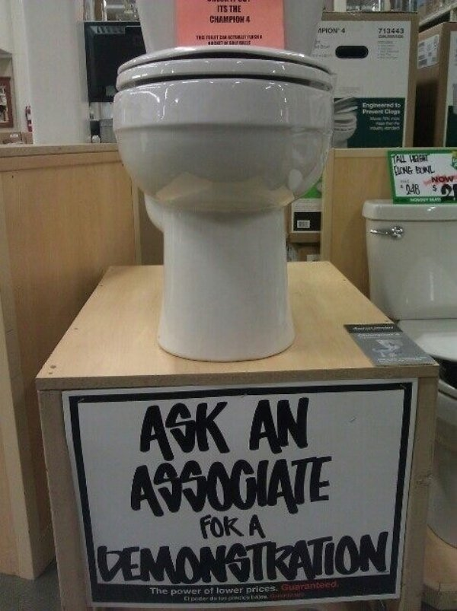
Demo Time

Slide 31

Then …
Questions and chatter
Contact Heidi Leckenby for advice, information or audits

